Slide 1
CSE 350 Data Communication
Lecture : Data & Signals

Slide 2
Data
Analog Data
Refers to information that is continuous.
Take on continuous values.
Example: an analog clock that has hour, minute and second hands gives information in continuous form.
Digital Data
Refers to information that has discrete states.
Take on discrete values.
Example: Data are stored in computer memory in the form of 0s and
1s.
.

Slide 3
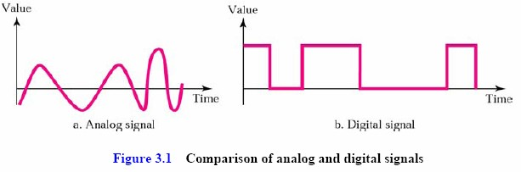
Signals
Analog Signals:
Analog signals can have an infinite number of values in a range.
Digital Signals:
Digital signals can have only a limited number of values.

Slide 4
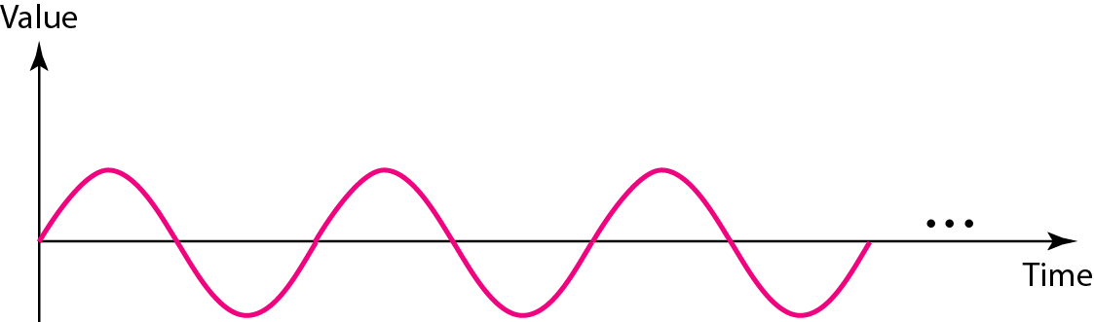
Signals
Periodic Analog Signal:
Completes a pattern within a measurable time frame, called a period.
Repeats that pattern over subsequent identical periods.
The completion of one full pattern is called a cycle.
Nonperiodic Analog Signal:
Changes without exhibiting a pattern or cycle that repeats over time.
Periodic analog signals can be classified as simple or composite.
A simple periodic analog signal, a sine wave, cannot be decomposed into simpler signals.
A composite periodic analog signal is composed of multiple sine waves.

Slide 5
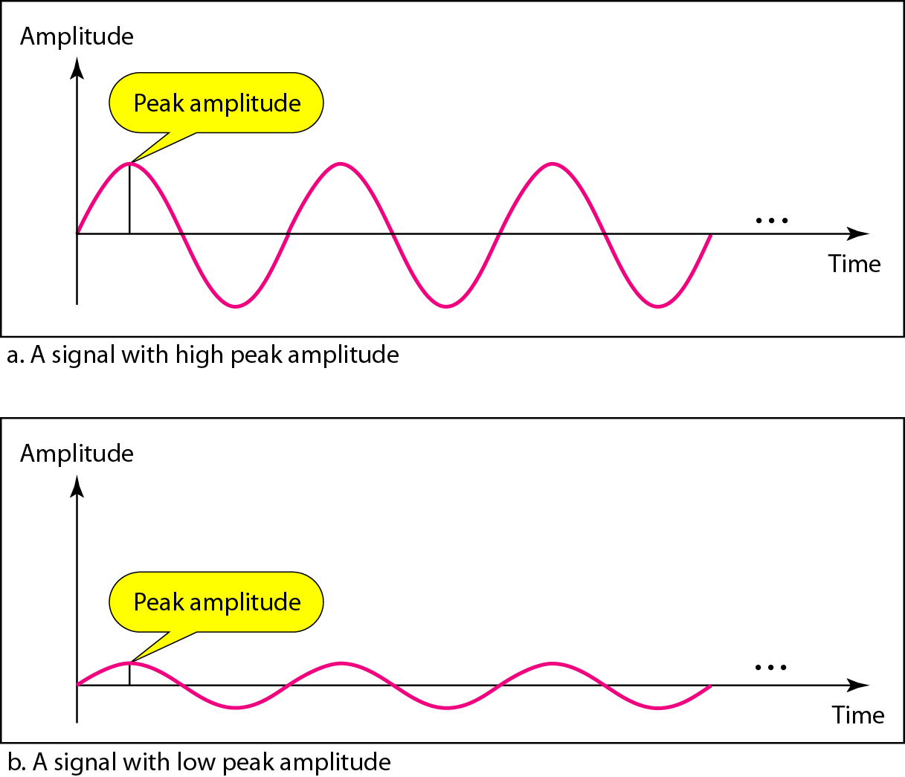
Signals
Sine Wave
Peak Amplitude of the signal is the absolute value of its highest intensity, proportional to the energy it carries.
Period and Frequency
Period refer to the amount of time in seconds, a signal needs to complete 1 cycle.
Frequency refers to the number of periods in 1 s.

Slide 6
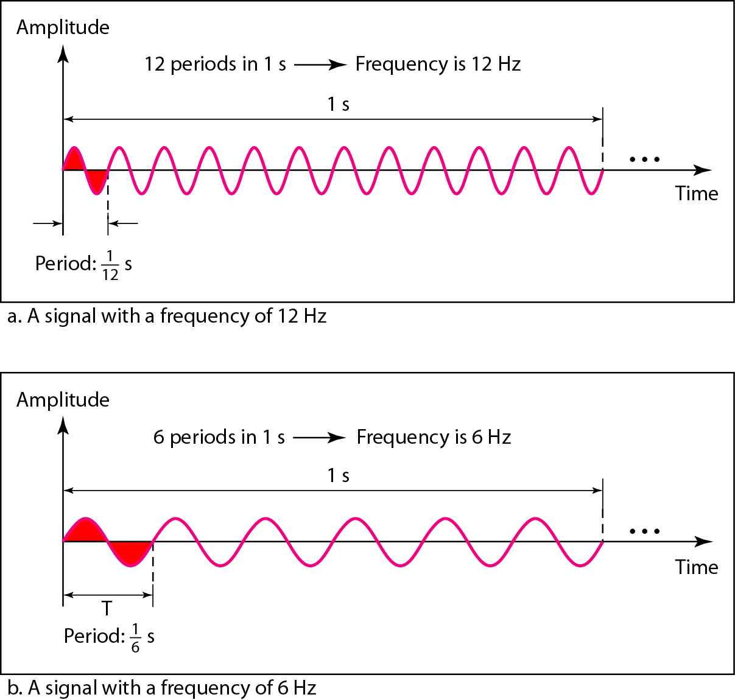
Frequency
Frequency is the rate of change with respect to time.
Change in a short span of time means high frequency.
Change over a long span of time means low frequency.
If a signal does not change at all, its frequency is zero
If a signal changes instantaneously, its frequency is infinite.
Frequency and period are the inverse of each other, f = 1/ T.

Slide 7
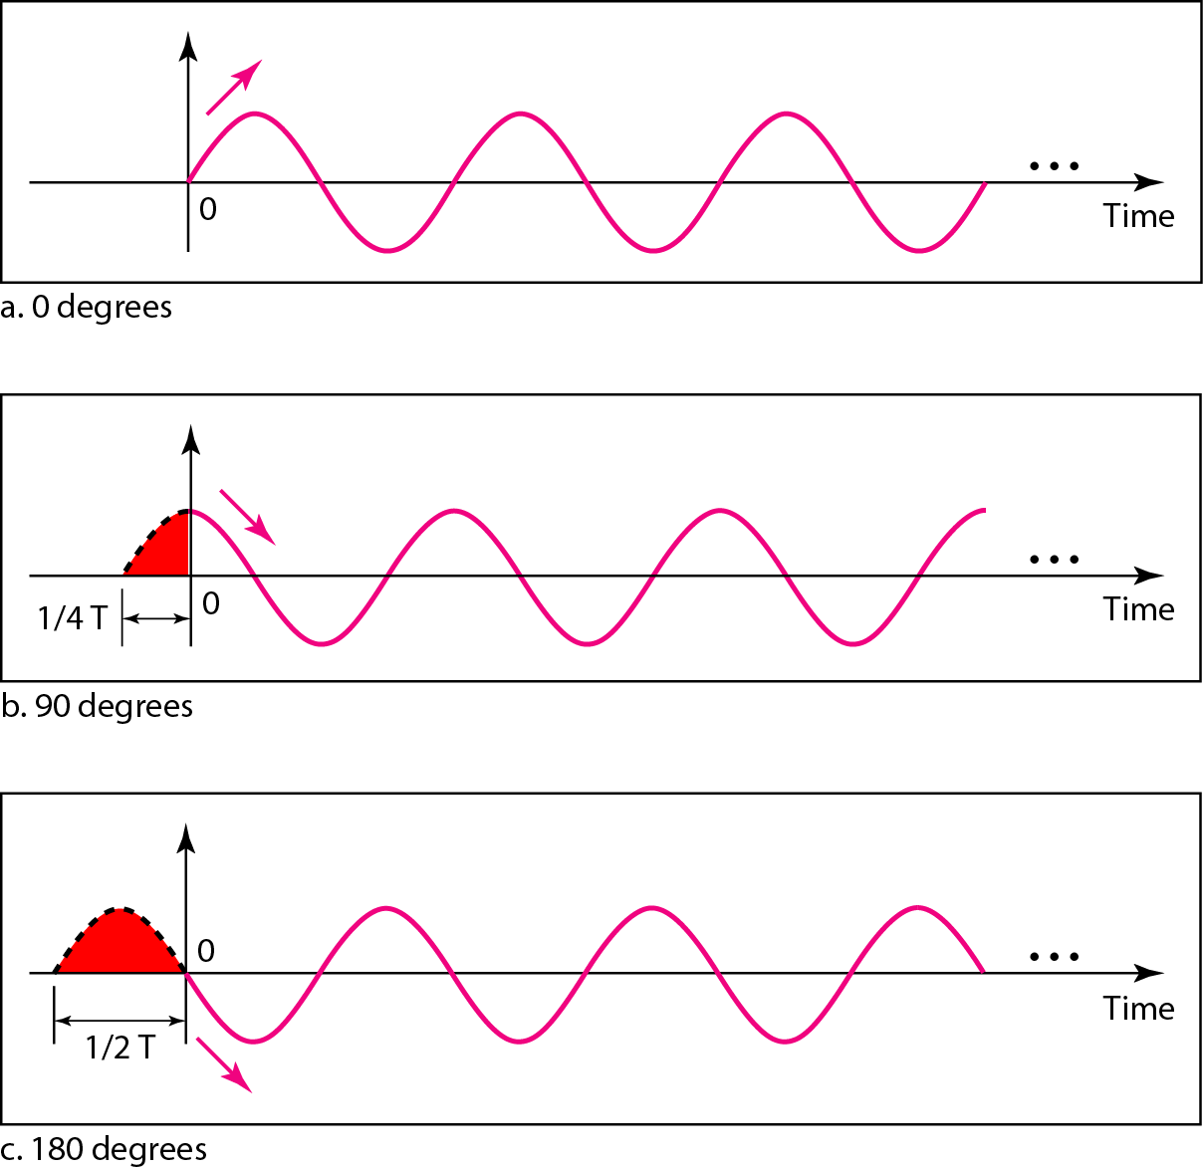
Phase
Phase:
Phase describes the position of the waveform relative to time 0.
Three sine waves with the same amplitude and frequency, but different phases.

Slide 8
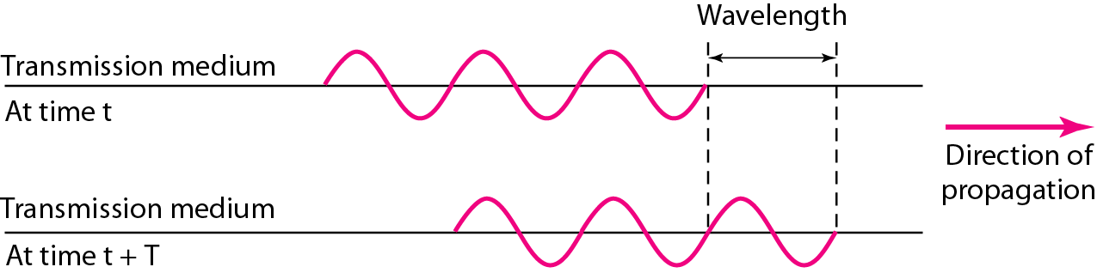
Wavelength and period
Wavelength:
is another characteristic of a signal traveling through a transmission medium.
Wavelength = Propagation speed x Period
= Propagation speed / Frequency

Slide 9
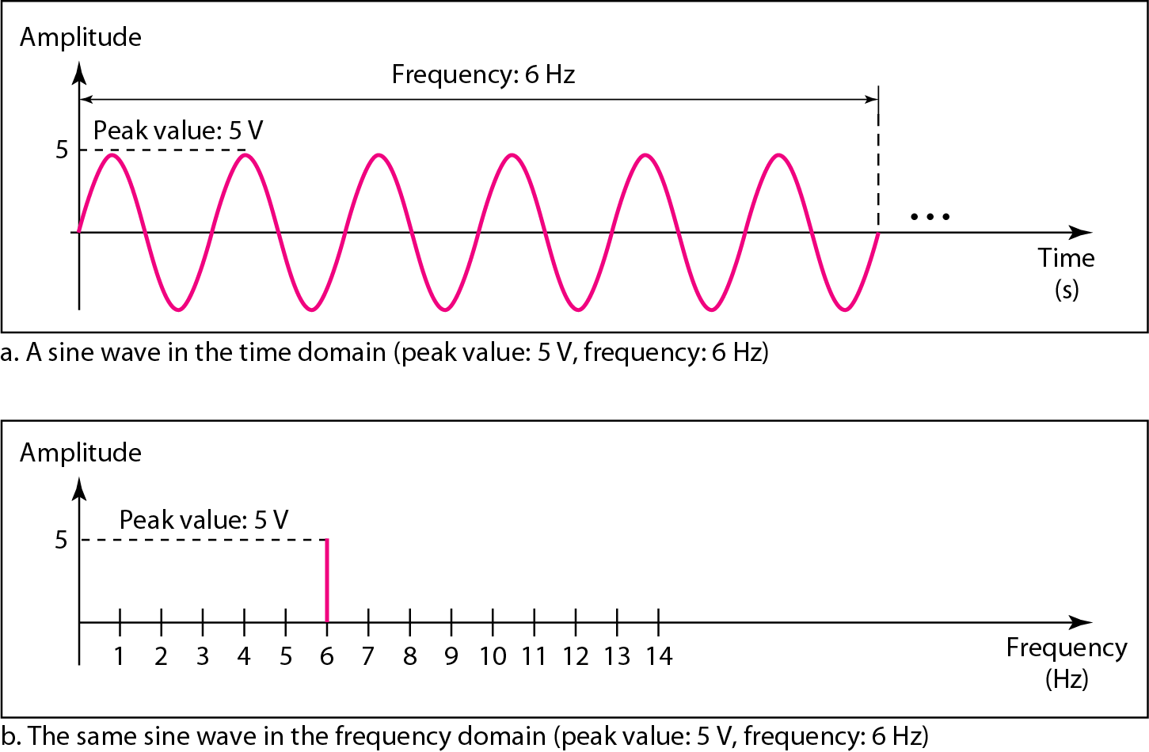
Time and Frequency Domains
A complete sine wave in the time domain can be represented by one single spike in the frequency domain.
Ti.me domain plot shows changes in signal amplitude with respect to time.
A frequency domain plot is concerned with only the peak value and the
frequency.

Slide 10
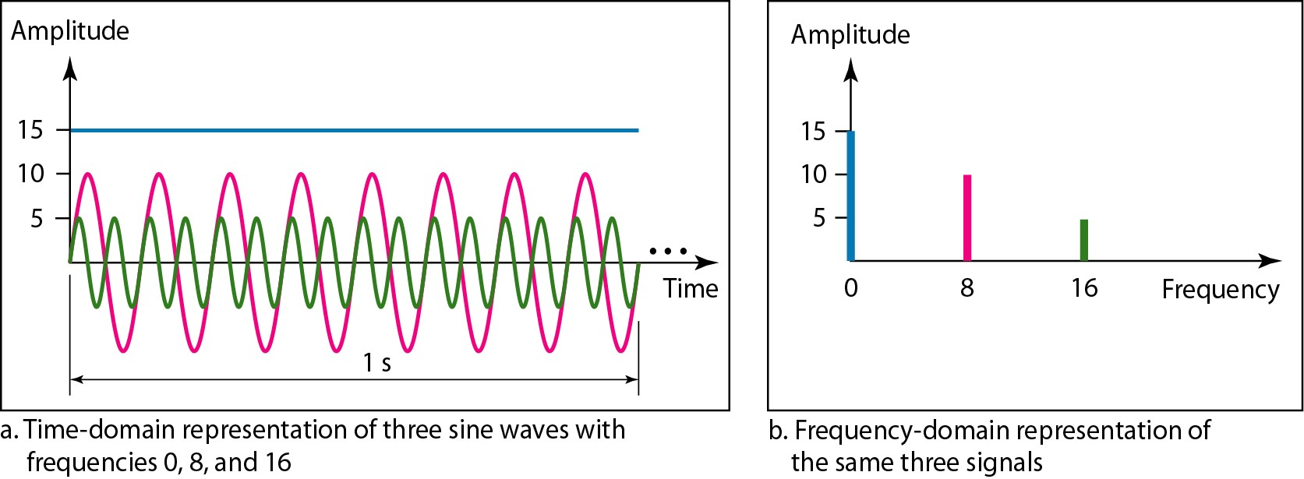
Frequency Domains
Time domain and frequency domain of three sine waves with frequencies 0, 8, 16.
The frequency domain is more compact and useful when we are dealing with more than one sine wave.
It is easy to plot and conveys information that one can find in a time domain plot.

Slide 11
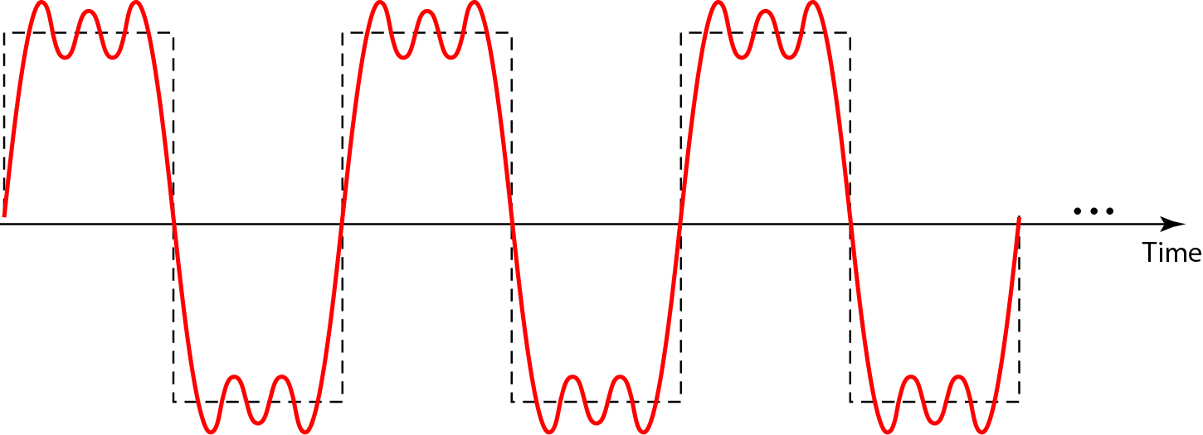
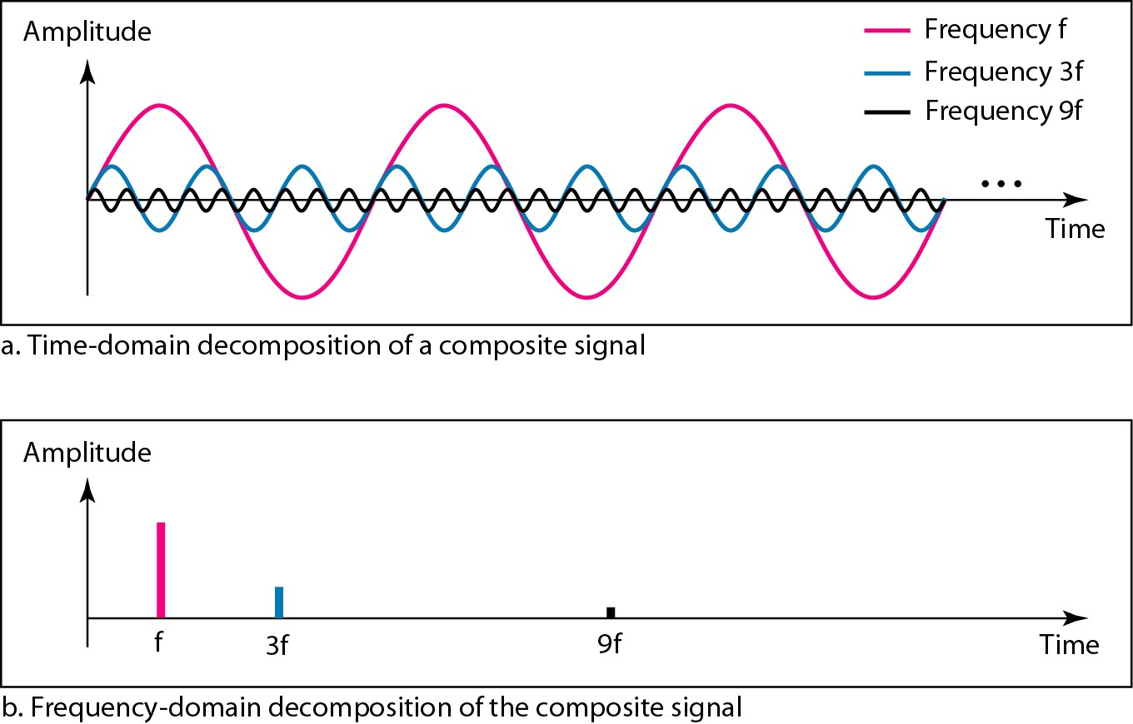
A composite periodic signal
If the composite signal is periodic, the decomposition gives a series of signals with discrete frequencies;
.
Figure- Decomposition of the composite periodic signal in the time and frequency domains

Slide 12
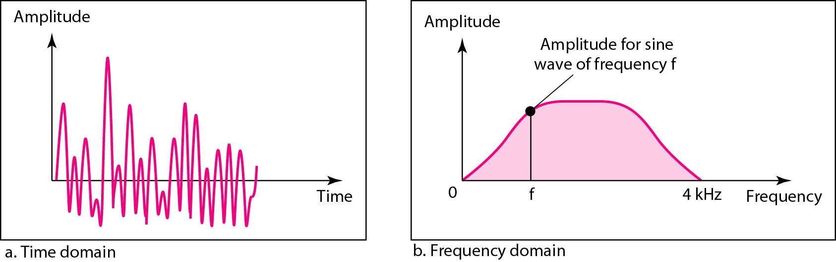
Time and frequency domains of a non periodic signal
A nonperiodic composite signal
If the composite signal is nonperiodic, the decomposition gives a combination
o. f sine waves with continuous frequencies.
It can be a signal created by a microphone or a telephone set when a word or
two is pronounced.
In this case, the composite signal cannot be periodic
because that implies that we are repeating the same word or words with exactly the same tone.

Slide 13
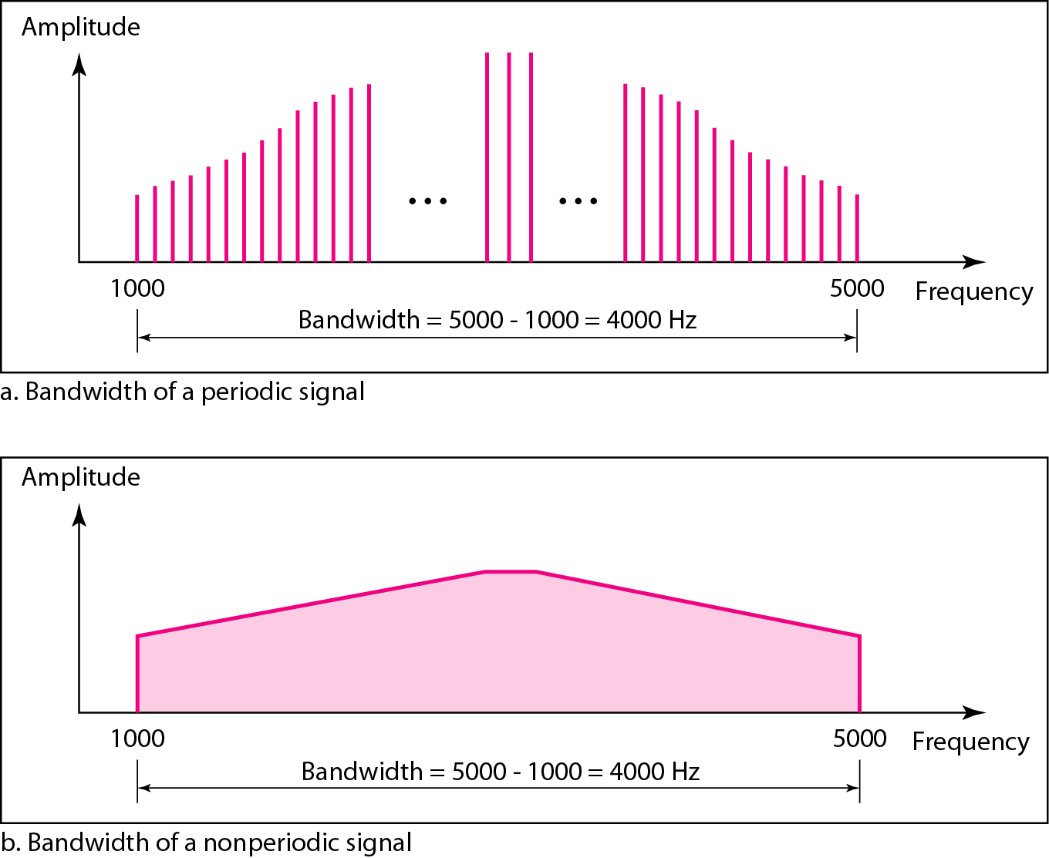
Bandwidth
The bandwidth of a composite signal is the difference between the highest and the lowest frequencies contained in that signal.

Slide 14
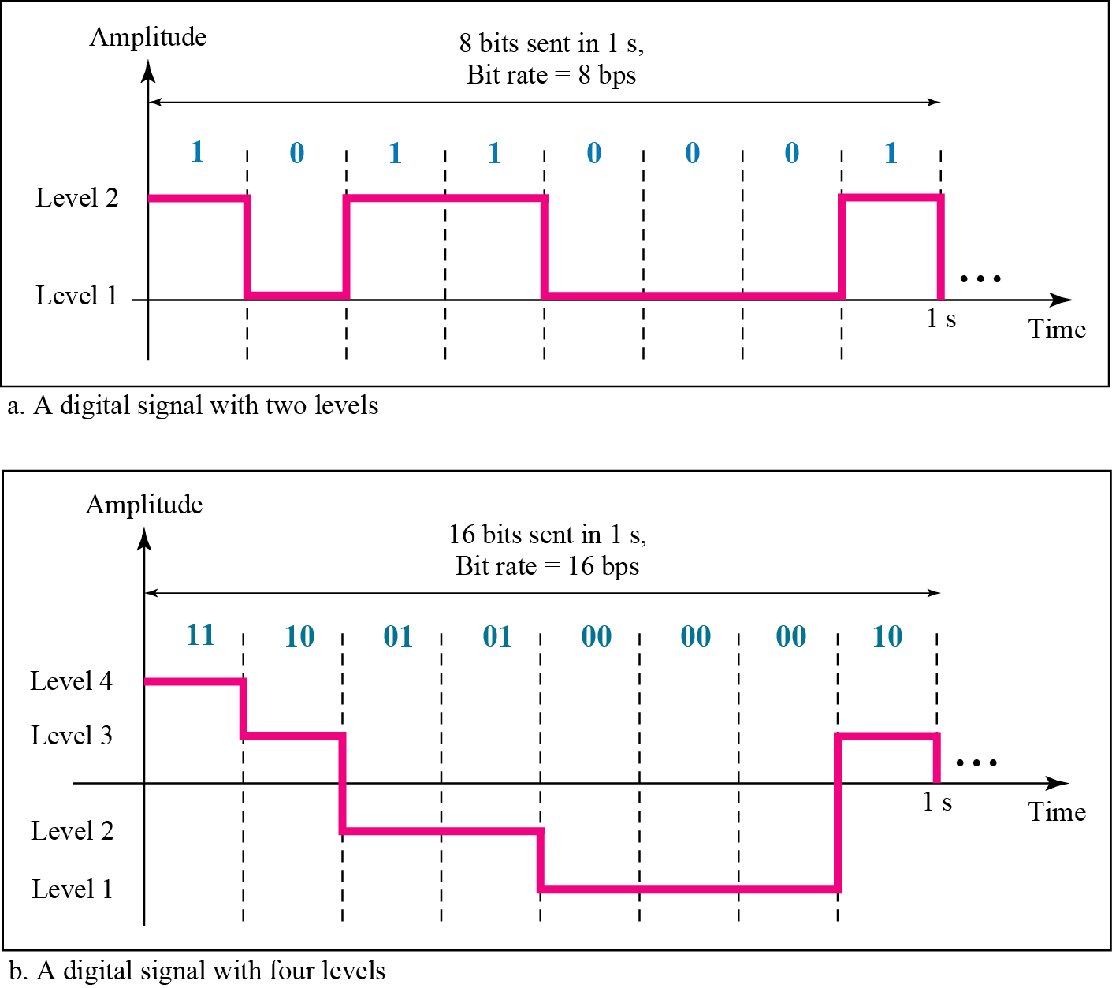
DIGITAL SIGNALS
In addition to being represented by an analog signal, information can also be represented by a digital signal.
For example, a 1 can be encoded as a positive voltage and a 0 as zero voltage.
A digital signal can have more than two levels.
In this case, we can send more than 1 bit for each level.

Slide 15
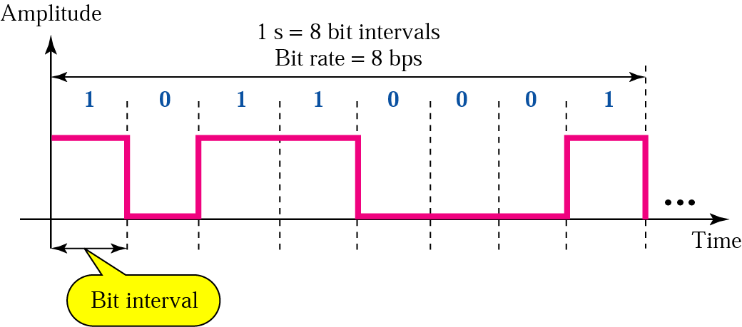
Bit Rate and Bit Interval
Bit rate –
is the number of bits sent in 1s.
. Expressed in bits per second(bps).
Bit length –
is the distance one bit occupies on the transmission medium.
Bit length = propagation speed x bit duration.

Slide 16
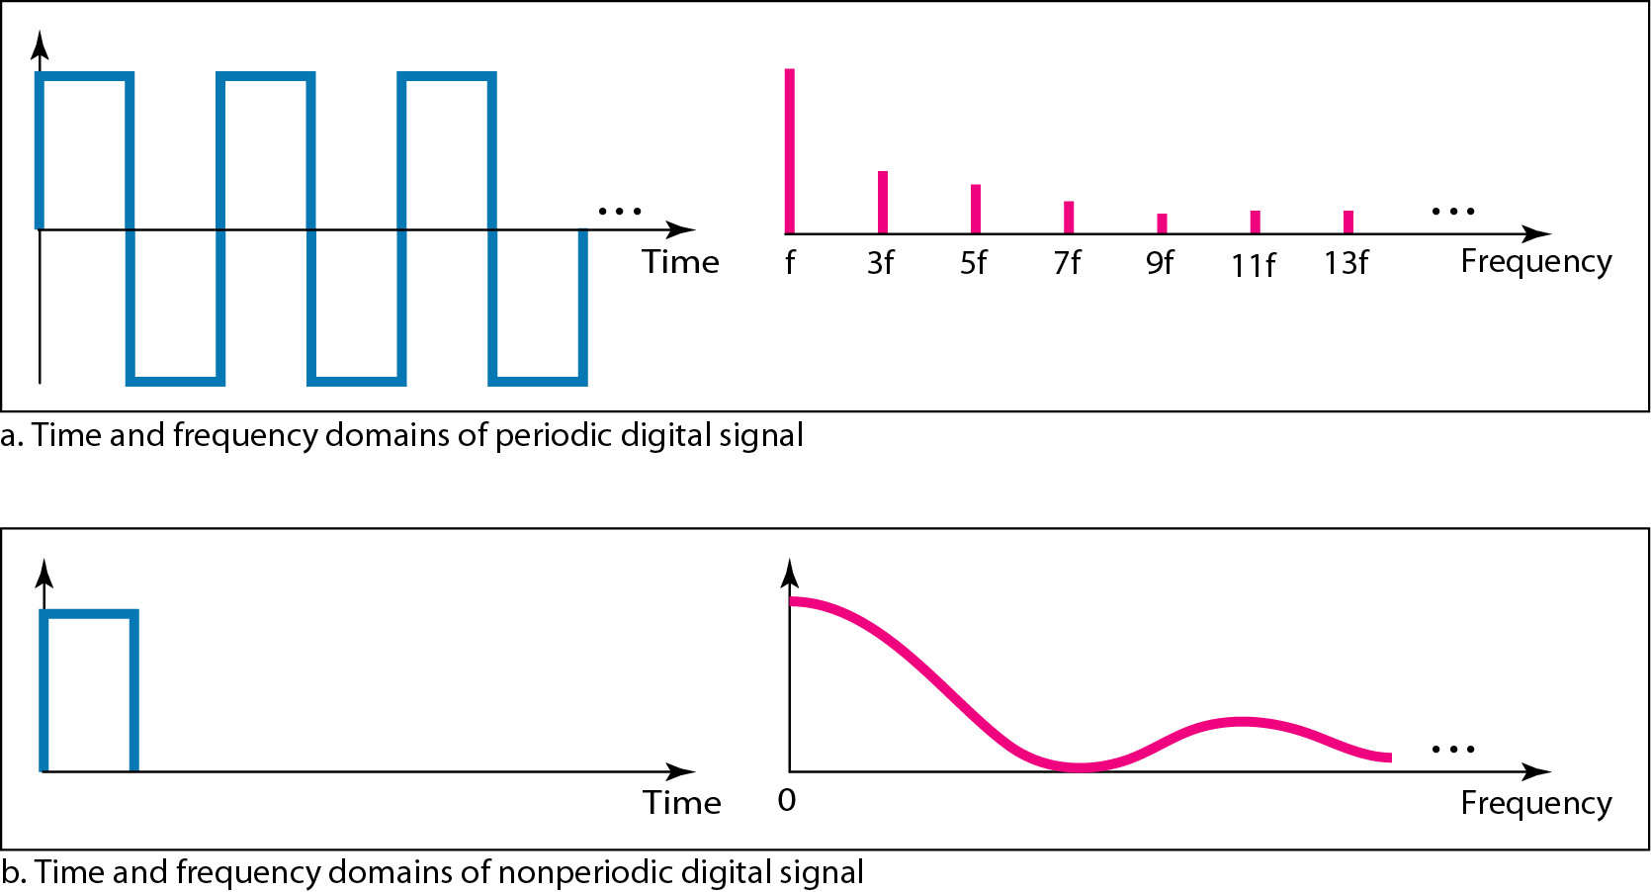
Digital Signal as a Composite Analog Signal

Slide 17
Transmission of Digital Signals
Baseband Transmission
means sending a digital signal over a channel without changing the digital
. signal to an analog signal.
o A digital signal is a composite analog signal with an infinite bandwidth.
Case1: Low-Pass Channel with Wide Bandwidth
Baseband transmission of a digital signal that preserves the shape of the digital signal is possible only if we have a low-pass channel with an infinite or very wide bandwidth.
Case2: Low-Pass Channel with Limited Bandwidth
In baseband transmission, the required bandwidth is proportional to the
bit rate; if we need to send bits faster, we need more bandwidth.

Slide 18
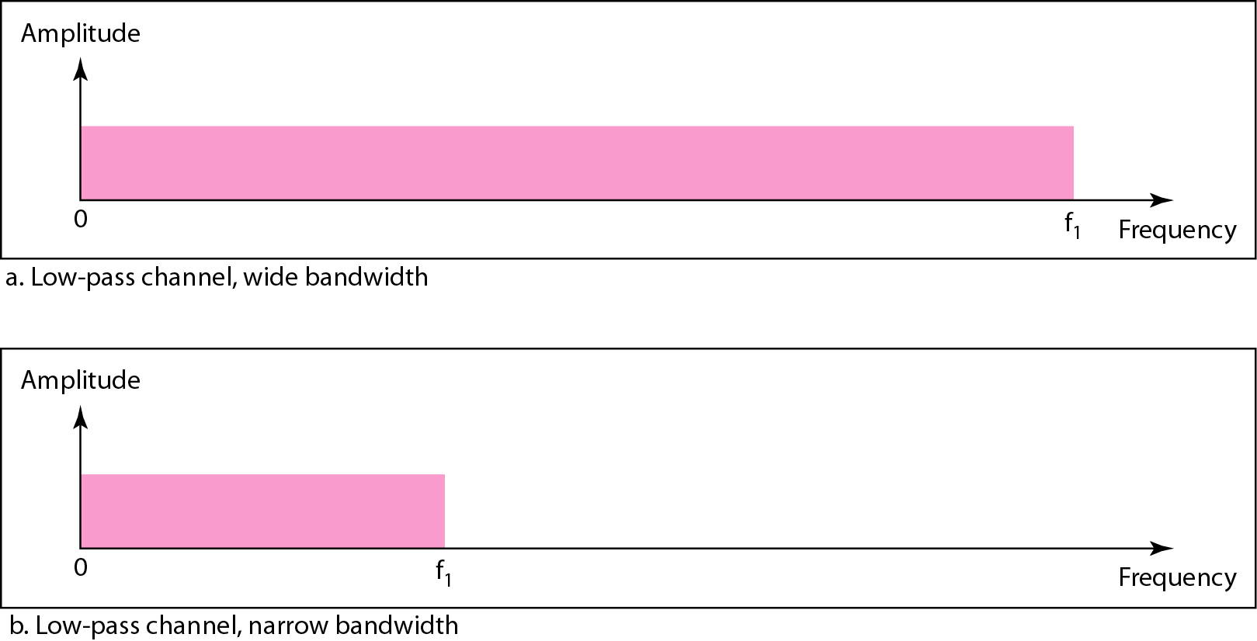
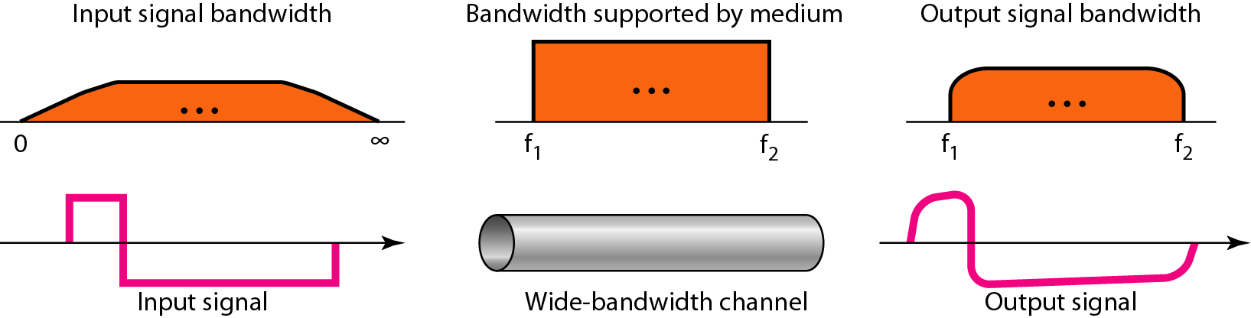
Transmission of Digital Signals
Figure- Bandwidths of two low-pass channels

Slide 19
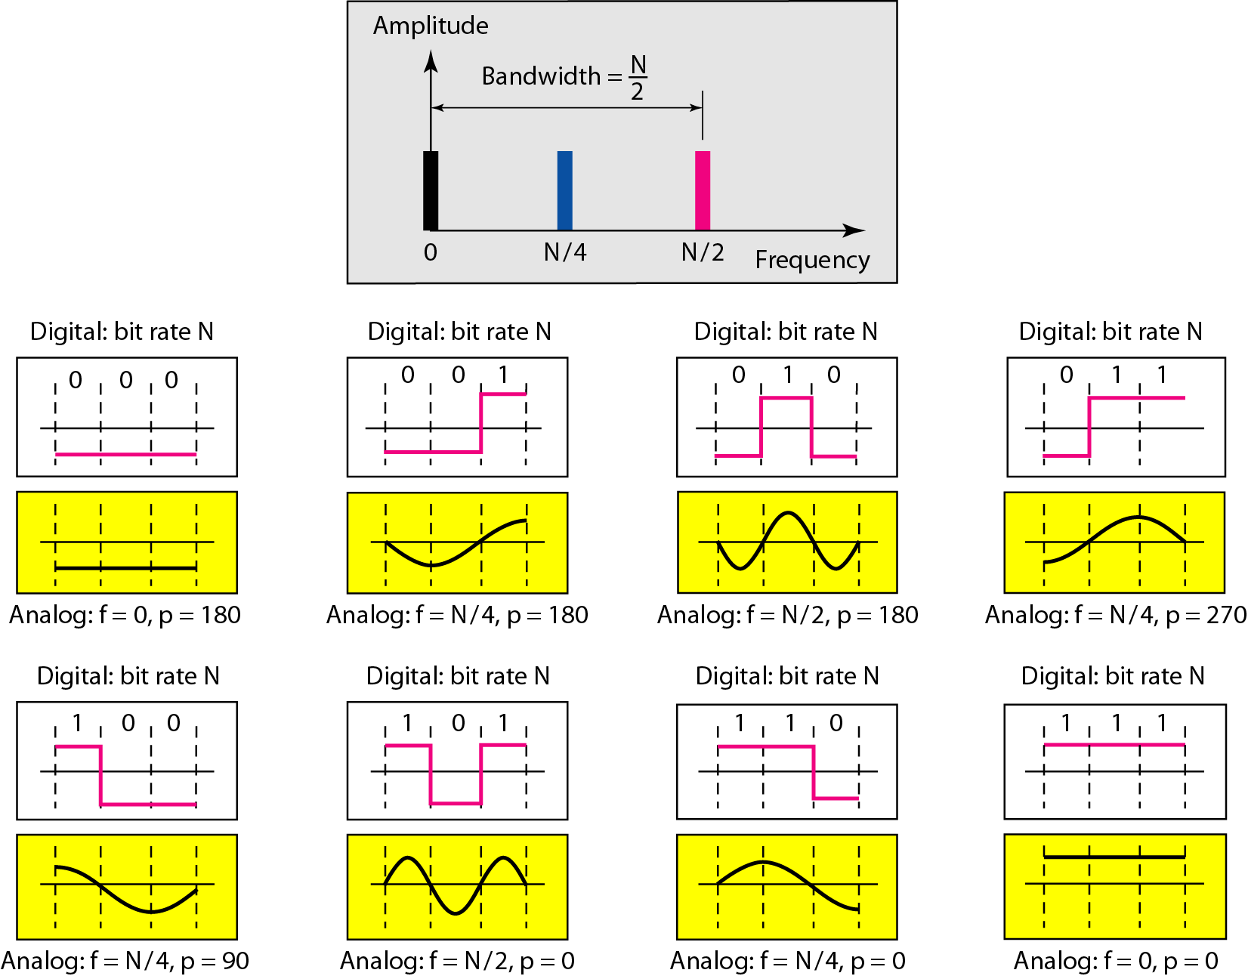
Transmission of Digital Signals
Low-Pass Channel with Limited Bandwidth
Figure - Rough approximation of a digital signal using the first harmonic for worst case

Slide 20
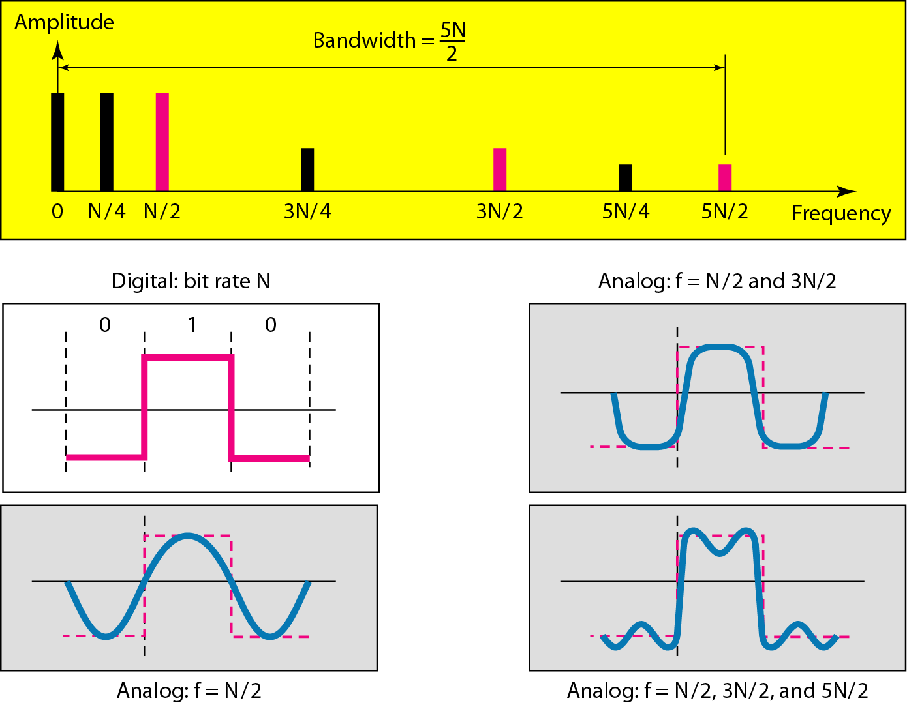
Transmission of Digital Signals
Low-Pass Channel with Limited Bandwidth
Figure - Simulating a digital signal with first three harmonics

Slide 21
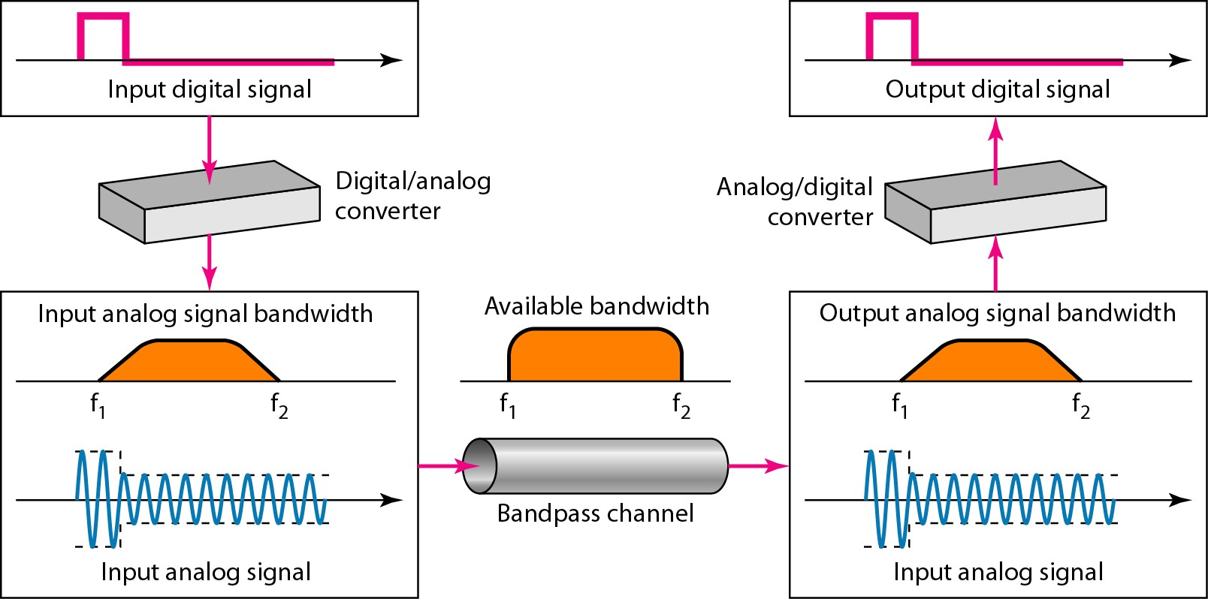
Transmission of Digital Signals
Broadband Transmission
Modulation allows us to use a bandpass channel.
✔. If the available channel is a bandpass channel, we cannot send the digital signal directly to the channel; we need to convert the digital signal to an analog signal before transmission.
Figure - Modulation for Bandpass Channel

Slide 22
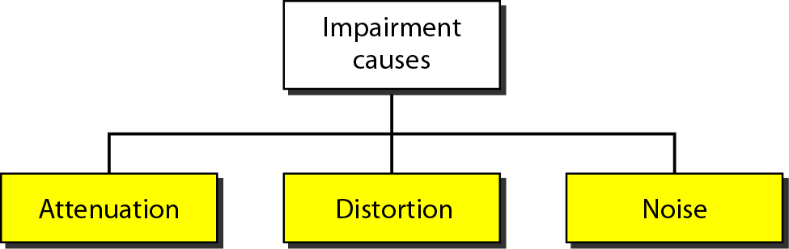
Transmission Impairment
Transmission Impairment
Signals travel through transmission media, which are not perfect.
The imperfection causes signal impairment.
Means that the signal at the beginning of the medium is not same as the signal at the end of the medium.
What is sent is not what is received.

Slide 23
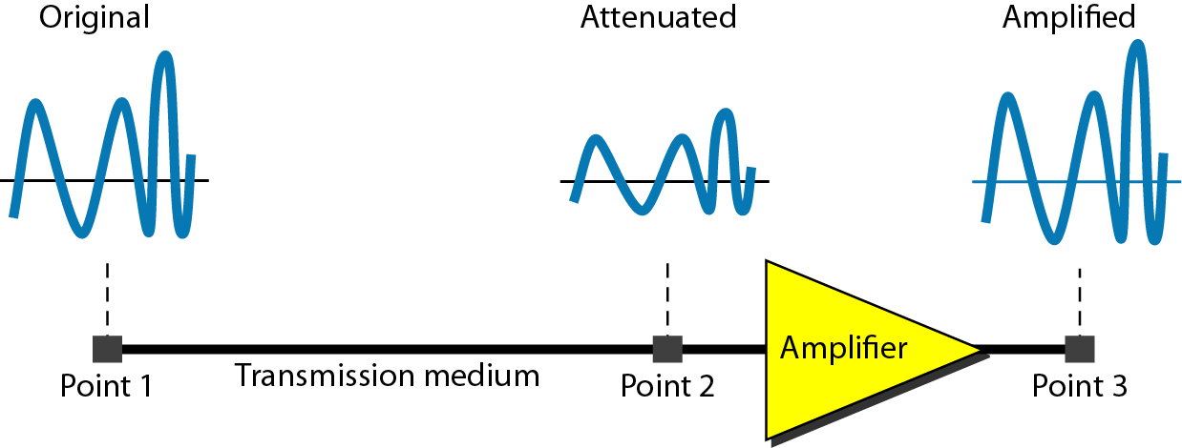

Transmission Impairment
Attenuation
Means loss of energy to overcome the resistance of the medium like as heat.
To compensate for this loss, amplifiers are used to amplify the signal.
Decibel (dB) measures the relative strengths of two signals or one signal at two different points.

Slide 24
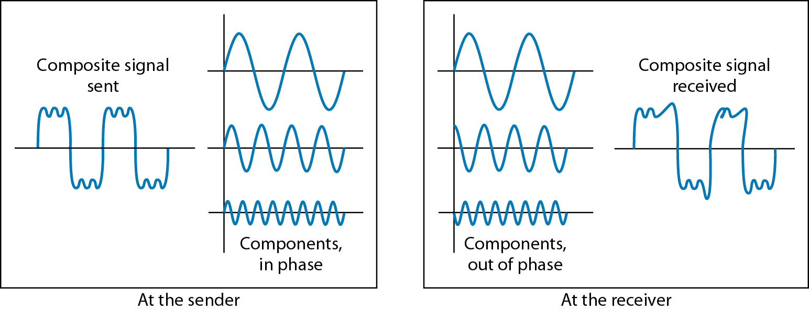
Transmission Impairment
Distortion
The signal changes its form or shape.
Each signal component in a composite signal has its own propagation speed.
Differences in delay may cause a difference in phase.

Slide 25
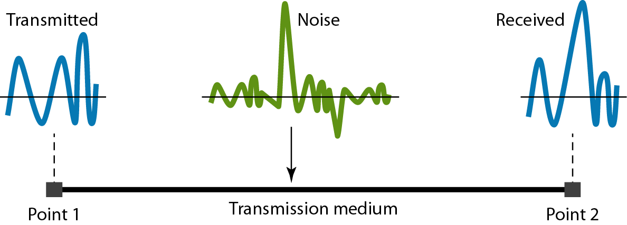
Transmission Impairment
Noise
Several types of noises, such as thermal noise, induced noise, crosstalk, and
impulse noise, may corrupt the signal.
Signal-to-Noise Ratio (SNR)
To find the theoretical bit rate limit
SNR = average signal power/average noise power
SNR_{dB} = 10 log₁₀ SNR

Slide 26
Data Rate Limits
A very important consideration in data communications is how fast we can send data, in bits per second, over a channel.
Data rate depends on three factors:
The bandwidth available
The level of the signals we use
The quality of the channel (the level of noise)
Noiseless channel: Nyquist Bit Rate
Bit rate = 2 * Bandwidth * log₂L, L is number of signal level
Increasing the levels may cause the reliability of the system
Noisy channel: Shannon Capacity
Capacity = Bandwidth * log₂(1 + SNR)
The Shannon capacity gives us the upper limit; the Nyquist formula tells us how many signal levels we need.

Slide 27
Performance
Bandwidth (in two contexts)
Bandwidth in hertz, refers to the range of frequencies in a composite signal
or the range of frequencies that a channel can pass.
Bandwidth in bits per second, refers to the speed of bit transmission in a channel or link.
Throughput
Measurement of how fast we can actually send data through a network.
Latency (Delay)
Define how long it takes for an entire message to completely arrive at the destination from the time the first bit is sent out from the source.
Latency = propagation time + transmission time + queuing time + processing
delay.
Propagation time = Distance/Propagation speed
Transmission time = Message size/Bandwidth

Slide 28
Thank you

